Slide 1
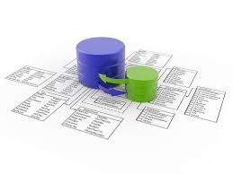
UNIT-V
RELATIONAL DATABASE DESIGN
MCA250 : RDBMS
Prof. C S Santhosh

Slide 2
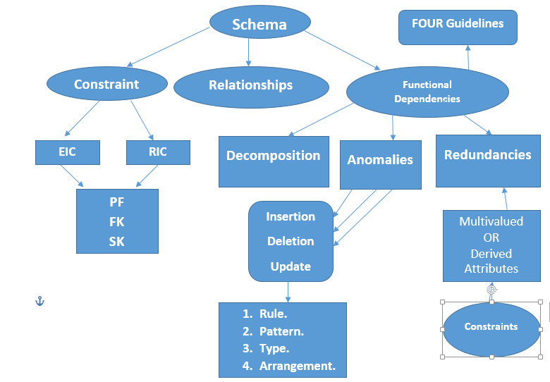

Slide 3

Features of Good Relational Design:
Schema Refinement :checking tables for redundancies and anomalies
Anomalies: a deviation from the common rule, type, arrangement, or form. an anomalous person or thing; one that is abnormal or does not fit in
Let’s see an example of redundancies and anomalies. Consider the following table where the client’s name is the primary key:

Slide 4
The table is presenting information on employees (sales reps) and their clients.
If we want to insert data, we notice that:
each row requires an entry in the client field
we can’t insert data for newly hired sales reps until they’ve been assigned to one or more clients
if sales reps are in a training process, even if they’ve been already hired, they can’t actually join the database because they need to have a delegated client… unless “dummy” clients are created.
If we want to update data, we notice that:
the sales reps name is repeated for each client.
what if, for a given client, we misspelled the name of the sales reps Crosby instead of Cosby… how can we edit that without affecting all the sales reps called Crosby?
If we want to delete data, what if Mary doesn’t have a client anymore because she’s taking a year off? We are forced to either
create a dummy client.
incorrectly showing her with a client she no longer handled
delete Mary’s record (even if however she’s still an employee)
notice we can not have “null” as a client since primary field keys cannot store null.

Slide 5
Update Anomalies: If one copy of such repeated data is updated, an inconsistency is created unless all copies are similarly updates.
Insertion Anomalies: It may not be possible to store certain information unless some other, unrelated information is stored as well.
Deletion Anomalies: It may not be possible to delete certain information unless some other, unrelated information is stored as well.
Redundant Storage:
Example :
Rating ------→123 ==>8 and 231 ==>8
Hourly-Wages -----→ 123 ==> 10 and 231 ==> 10

Slide 6
Update Anomalies: Here in hourly-wages the first tuple can be uploaded without making changes in second tuple.
Insertion Anomalies: We can insert a tuple for an employee unless we know the hourly-wages for the employee rating value.
Deletion Anomalies: If we delete all tuples with a given rating value.
Decomposition : is the process of breaking down in parts or elements. It replaces a relation with a collection of smaller relations. It breaks the table into multiple tables in a database. ... If there is no proper decomposition of the relation, then it may lead to problems like loss of information.
Ex: Hourly-Emp1 ( SSN , Name ,Lot ,Rating ,Hours-Worked , Hourly-wages)
After Decomposition, the above table becomes,
Hourly-Emp2( SSN , Name, Lot, Rating , Hours-worked)
Wages ( Rating, Hourly-Wages)

Slide 7
Informal Guidelines
INFORMAL DESIGN GUIDELINES FOR RELATIONAL SCHEMA.
1.Semantics of the Attributes. ( Type of Value )
2.Reducing the Redundant Value in Tuples. (Unambiguous)
3.Reducing Null values in Tuples. ( # , ( ) )
4.Dissallowing spurious Tuples.

Slide 8
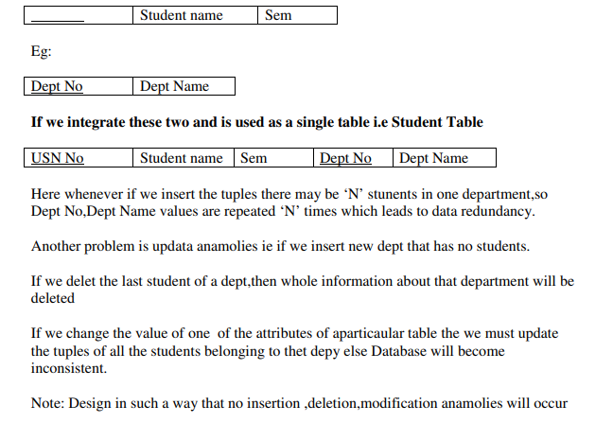
Reducing the Redundant Value in Tuples
Mixing attributes of multiple entities may cause problems
Information is stored redundantly wasting storage
Problems with update anomalies
Insertion anomalies
Deletion anomalies
Modification anomalies

Slide 9
Semantics of the Attributes
Whenever we are going to form relational schema there should be some meaning among the attributes. This meaning is called semantics. This semantics relates one attribute to another with some relation.
Eg:
USN No , Student name , Sem
NOTE : Design a relational schema so that, it is easy to explain its meaning. Don’t combine attributes from multiple entity and relationship types.
Once such goal of schema is to minimize, then the storage space where the base relation occupies.

Slide 10
Reducing Null values in Tuples.
Note: Relations should be designed such that their tuples will have as few NULL
values as possible
Attributes that are NULL frequently could be placed in separate relations (with the
primary key)
Reasons for nulls:
attribute not applicable or invalid
attribute value unknown (may exist)
value known to exist, but unavailable

Slide 11
Disallowing spurious Tuples
A spurious tuple is, basically, a record in a database that gets created when two tables are joined badly. In databases, spurious tuples are created when two tables are joined on attributes that are neither primary keys nor foreign keys.
Bad designs for a relational database may result in erroneous results for certain JOIN
operations
The "lossless join" property is used to guarantee meaningful results for join
operations
Note: The relations should be designed to satisfy the lossless join condition.
No spurious tuples should be generated by doing a natural-join of any
relations.

Slide 12
Functional Dependencies
When we have to treat with schema refinement we often notice that the main problem is redundancy. In order to identify schemas with such problems, we’ll introduce the notion of functional dependencies: a relationship that exists when one attribute uniquely determines another attribute. A functional dependency is simply a new type of constraint between two attributes.
Say that R is a relation with attributes X and Y, we say that there is a functional dependency X -> Y when Y is functionally dependent on X (where X is the determinant set and Y is the dependent attribute).

Slide 13
Let’s illustrate a scenario where the designer didn’t take in consideration dependencies between columns.
Data (studID, studName, address, courseID, courseName, grade)
The following structure is considerably better:
Student(studID, studName, address)
Course (courseID, courseName)
Enrolled (studID, courseID, grade)
How do we pass from one to the other?
That’s what schema refinement does through functional dependencies.

Slide 14
A unique way to represent a student is through his studID. Each student has his own address, hence we can say that studID determines address. We’ll write this in the following way:
studID - > address
In the previous example, we actually have the following FDs:
studID - > studName, address
courseID - > courseName
studID, courseID - > grade

Slide 15
Let’s have a look at the properties of functional dependencies in the case where X, Y and Z are attributes belonging to a table R :
transitivity: if we assume that X - > Y and Y - > Z, then it’s clear that X - > Z
reflexivity: if Y is a subset of X, then X -> Y
augmentation: if X - > Y, then for any Z we’ll have X, Z - > Y, Z
union: if X - > Y and Y - > Z, then X - > Y, Z
decomposition: if X -> Y, Z then X - > Y and X - > Z
The first 3 properties are called the Armstrong’s Axioms.

Slide 16
If F is a set of functional dependencies, F+ is the set of all FDs logically implied by F. Logically implied is just another way of saying obtained from the properties of functional dependencies ( the ones that we just enumerated).
F+ is also called the closure of the set of functional dependencies. It is the set of all dependencies logically implied by those present in F.
Let’s illustrate the usage of those properties with an example. If we have the following set of FDs, can we conclude that A - > H is logically implied?
A - > B
A - > C
C, G - > H
C, G - > I
B - > H

Slide 17
Let’s see which properties are applicable to our case:
We know that, by the transitivity property, if X -> Y and Y - > Z then we have X -> Z In our case we have A - > B and B - > H.
Hence, by transitivity, A - > H is logically implied.
Which other dependencies are part of the closure?
CG -> HI by the union rule
AG -> I by noticing that A -> C holds, and then AG -> CG by the augmentation rule and then AG -> I by transitivity.

Slide 18
Trivial Functional Dependency
Trivial − If a functional dependency (FD) X → Y holds, where Y is a subset of X, then it is called a trivial FD. Trivial FDs always hold.
Non-trivial − If an FD X → Y holds, where Y is not a subset of X, then it is called a non-trivial FD.
Completely non-trivial − If an FD X → Y holds, where x intersect Y = Φ, it is said to be a completely non-trivial FD
Closure
The set of all those attributes which can be functionally determined from an attribute set is called as a closure of that attribute set.
Closure of attribute set {X} is denoted as {X}⁺.
LINK : https://www.gatevidyalay.com/closure-of-an-attribute-set/#:~:text=Closure%20of%20an%20Attribute%20Set,denoted%20as%20%7BX%7D%2B.

Slide 19
Normalization
If a database design is not perfect, it may contain anomalies, which are like a bad dream for any database administrator. Managing a database with anomalies is next to impossible.
Normalization is a method to remove all these anomalies and bring the database to a consistent state.
Normalization Avoids:
Duplication of Data - The same data is listed in multiple lines of the database
Insert Anomaly - A record about an entity cannot be inserted into the table without first inserting information about another entity - Cannot enter a customer without a sales order
Delete Anomaly - A record cannot be deleted without deleting a record about a related entity. Cannot delete a sales order without deleting all of the customer's information.
Update Anomaly - Cannot update information without changing information in many places. To update customer information, it must be updated for each sales order the customer has placed
Normalization is the process of minimizing redundancy from a relation or set of relations

Slide 20
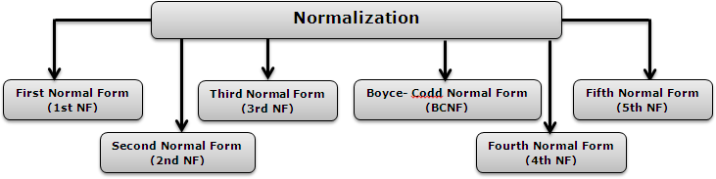
Normalization is a Six stage process - After the first stage, the data is said to be in first normal form, after the second, it is in second normal form, after the third, it is in third normal form and so on.

Slide 21
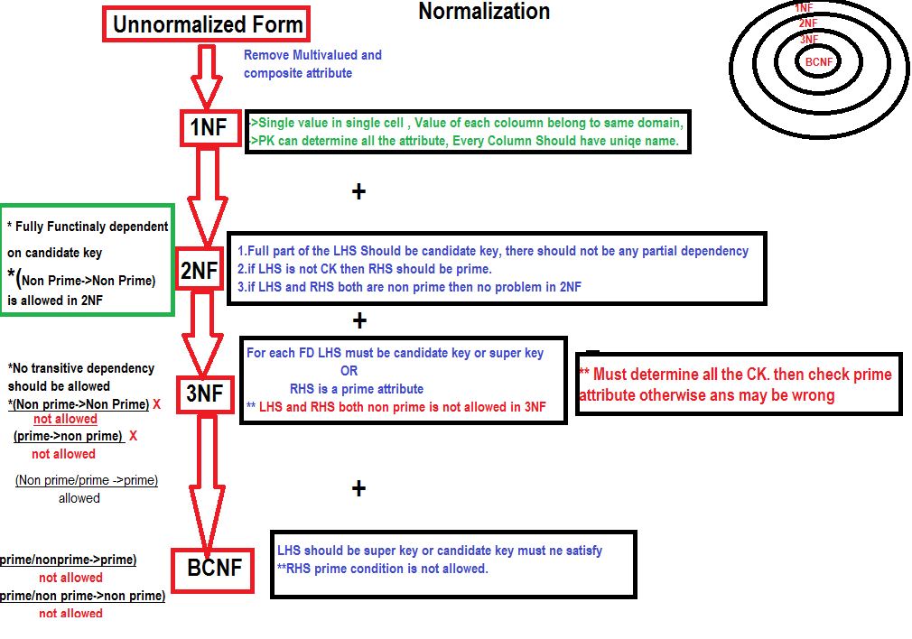

Slide 22
Normalization of Database
Database Normalization is a technique of organizing the data in the database.
Normalization is a systematic approach of decomposing tables to eliminate data redundancy(repetition) and undesirable characteristics like Insertion, Update and Deletion Anomalies. It is a multi-step process that puts data into tabular form, removing duplicated data from the relation tables.
Normalization is used for mainly two purposes,
Eliminating redundant(useless) data.
Ensuring data dependencies make sense i.e data is logically stored.
URL : https://youtu.be/xoTyrdT9SZI

Slide 23
First Normal Form ( 1NF)
A relation will be 1NF if it contains an atomic value.
It states that an attribute of a table cannot hold multiple values. It must hold only single-valued attribute.
First normal form disallows the multi-valued attribute, composite attribute, and their combinations.
Example: Relation EMPLOYEE is not in 1NF because of multi-valued attribute EMP_PHONE
EMP_ID | EMP_NAME | EMP_PHONE | EMP_STATE
14 | John | 7272826385, 9064738238 | UP
20 | Harry | 8574783832 | Bihar
12 | Sam | 7390372389, 8589830302 | Punjab
EMPLOYEE table:

Slide 24
The decomposition of the EMPLOYEE table into 1NF has been shown below:
EMP_ID | EMP_NAME | EMP_PHONE | EMP_STATE
14 | John | 7272826385 | UP
14 | John | 9064738238 | UP
20 | Harry | 8574783832 | Bihar
12 | Sam | 7390372389 | Punjab
12 | Sam | 8589830302 | Punjab

Slide 25
Second Normal Form ( 2NF)
In the 2NF, relational must be in 1NF.
In the second normal form, all non-key attributes are fully functional dependent on the primary key
Example: Let's assume, a school can store the data of teachers and the subjects they teach. In a school, a teacher can teach more than one subject.
In the given table, non-prime attribute TEACHER_AGE is dependent on TEACHER_ID which is a proper subset of a candidate key. That's why it violates the rule for 2NF.
TEACHER_ID | SUBJECT | TEACHER_AGE
25 | Chemistry | 30
25 | Biology | 30
47 | English | 35
83 | Math | 38
83 | Computer | 38
TEACHER table

Slide 26
To convert the given table into 2NF, we decompose it into two tables:
TEACHER_DETAIL table:
TEACHER_ID | TEACHER_AGE
25 | 30
47 | 35
83 | 38
TEACHER_ID | SUBJECT
25 | Chemistry
25 | Biology
47 | English
83 | Math
83 | Computer
TEACHER_SUBJECT table:

Slide 27
Third Normal Form ( 3NF)
A relation will be in 3NF if it is in 2NF and not contain any transitive partial dependency.
3NF is used to reduce the data duplication. It is also used to achieve the data integrity.
If there is no transitive dependency for non-prime attributes, then the relation must be in third normal form.
A relation is in third normal form if it holds atleast one of the following conditions for every non-trivial function dependency X → Y.
X is a super key.
Y is a prime attribute, i.e., each element of Y is part of some candidate key.

Slide 28
Example:
EMP_ID | EMP_NAME | EMP_ZIP | EMP_STATE | EMP_CITY
222 | Harry | 201010 | UP | Noida
333 | Stephan | 02228 | US | Boston
444 | Lan | 60007 | US | Chicago
555 | Katharine | 06389 | UK | Norwich
666 | John | 462007 | MP | Bhopal
EMPLOYEE_DETAIL table:
Super key in the table above:
{EMP_ID}, {EMP_ID, EMP_NAME}, {EMP_ID, EMP_NAME, EMP_ZIP}....so on
Candidate key: {EMP_ID}
Non-prime attributes: In the given table, all attributes except EMP_ID are non-prime.
Here, EMP_STATE & EMP_CITY dependent on EMP_ZIP and EMP_ZIP dependent on EMP_ID. The non-prime attributes (EMP_STATE, EMP_CITY) transitively dependent on super key(EMP_ID). It violates the rule of third normal form.
That's why we need to move the EMP_CITY and EMP_STATE to the new <EMPLOYEE_ZIP> table, with EMP_ZIP as a Primary key.

Slide 29
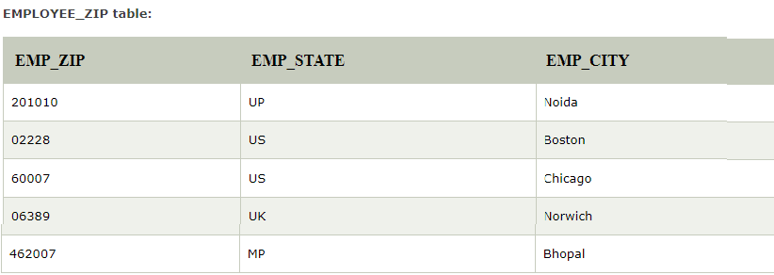
EMPLOYEE table:
EMP_ID | EMP_NAME | EMP_ZIP
222 | Harry | 201010
333 | Stephan | 02228
444 | Lan | 60007
555 | Katharine | 06389
666 | John | 462007

Slide 30
Boyce Codd normal form (BCNF)
Boyce and Codd Normal Form is a higher version of the Third Normal form. This form deals with certain type of anomaly that is not handled by 3NF. A 3NF table which does not have multiple overlapping candidate keys is said to be in BCNF. For a table to be in BCNF, following conditions must be satisfied:
R must be in 3rd Normal Form.
and, for each functional dependency ( X → Y ), X should be a super Key.
For BCNF, the table should be in 3NF, and for every FD, LHS is super key.
Example: Let's assume there is a company where employees work in more than one department.

Slide 31
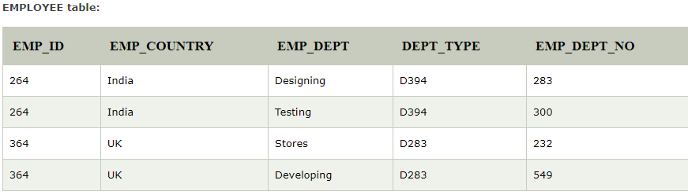
In the above table Functional dependencies are as follows:
EMP_ID → EMP_COUNTRY
EMP_DEPT → {DEPT_TYPE, EMP_DEPT_NO}
Candidate key: {EMP-ID, EMP-DEPT}
The table is not in BCNF because neither EMP_DEPT nor EMP_ID alone are keys.
To convert the given table into BCNF, we decompose it into three tables:

Slide 32
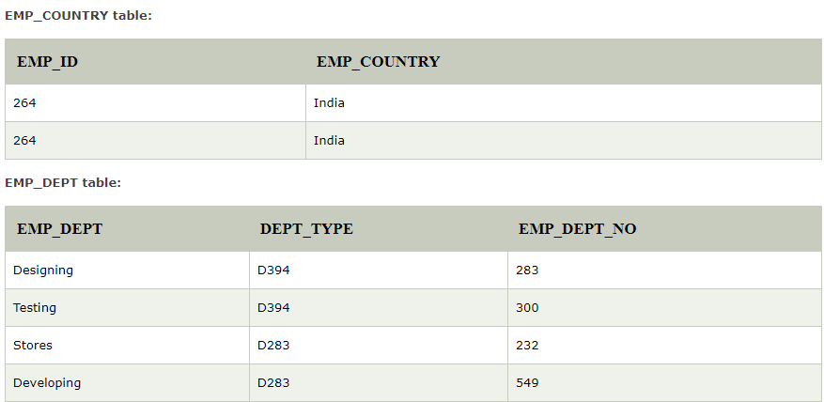

Slide 33
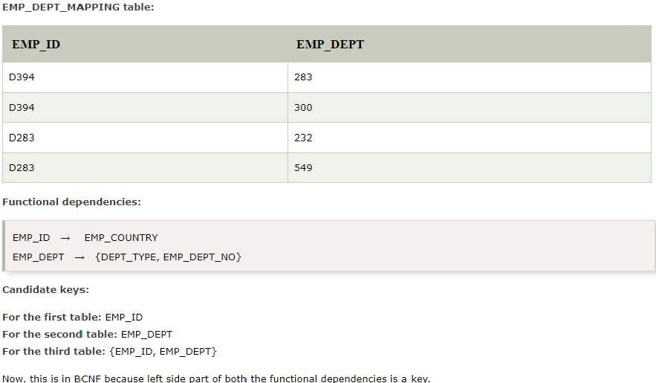

Slide 34
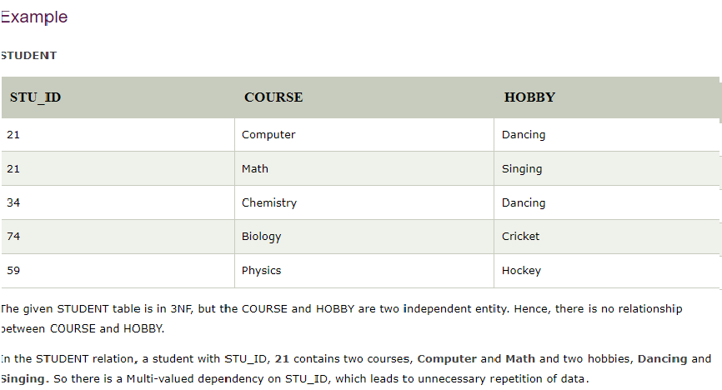
Fourth Normal Form ( 4NF)
A relation will be in 4NF if it is in Boyce Codd normal form and has no multi-valued dependency.
For a dependency A → B, if for a single value of A, multiple values of B exists, then the relation will be a multi-valued dependency.

Slide 35



Slide 36
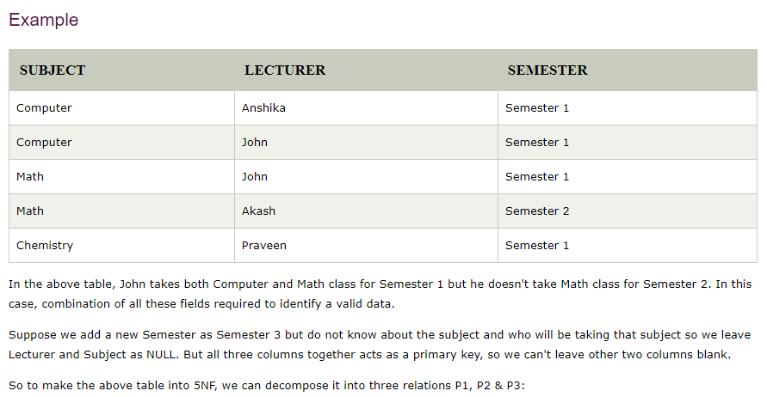
Fifth Normal Form ( 5 NF)
A relation is in 5NF if it is in 4NF and not contains any join dependency and joining should be lossless.
5NF is satisfied when all the tables are broken into as many tables as possible in order to avoid redundancy.
5NF is also known as Project-join normal form (PJ/NF).

Slide 37



Slide 38


Slide 39
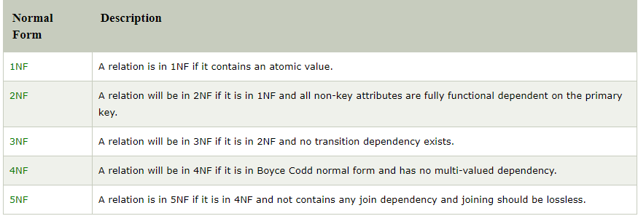
URL’s for All the Normal Forms:
1NF : https://youtu.be/mUtAPbb1ECM
2NF : https://youtu.be/R7UblSu4744
3NF : https://youtu.be/aAx_JoEDXQA
BCNF : https://youtu.be/NNjUhvvwOrk
4NF : https://youtu.be/OTCuykFHBeA
5NF : https://youtu.be/mbj3HSK28Kk

Slide 40
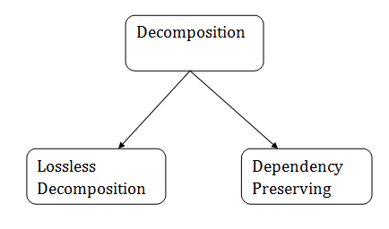
Relational Decomposition
When a relation in the relational model is not in appropriate normal form then the decomposition of a relation is required.
In a database, it breaks the table into multiple tables.
If the relation has no proper decomposition, then it may lead to problems like loss of information.
Decomposition is used to eliminate some of the problems of bad design like anomalies, inconsistencies, and redundancy.

Slide 41
Lossless Decomposition:
If the information is not lost from the relation that is decomposed, then the decomposition will be lossless.
The lossless decomposition guarantees that the join of relations will result in the same relation as it was decomposed.
The relation is said to be lossless decomposition if natural joins of all the decomposition give the original relation.
Dependency Preserving:
It is an important constraint of the database.
In the dependency preservation, at least one decomposed table must satisfy every dependency.
If a relation R is decomposed into relation R1 and R2, then the dependencies of R either must be a part of R1 or R2 or must be derivable from the combination of functional dependencies of R1 and R2.
For example, suppose there is a relation R (A, B, C, D) with functional dependency set (A->BC). The relational R is decomposed into R1(ABC) and R2(AD) which is dependency preserving because FD A->BC is a part of relation R1(ABC).

Slide 42
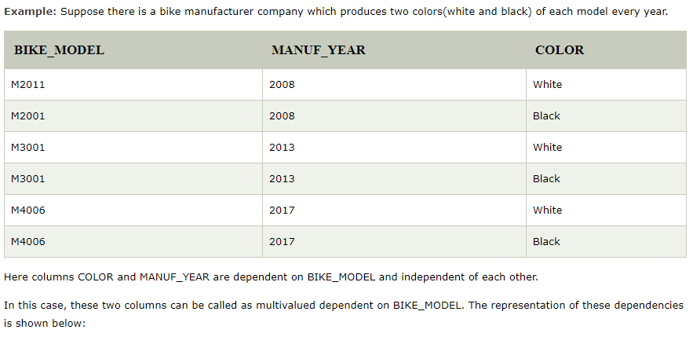
Multivalued Dependency:
Multivalued dependency occurs when two attributes in a table are independent of each other but, both depend on a third attribute.
A multivalued dependency consists of at least two attributes that are dependent on a third attribute that's why it always requires at least three attributes.
BIKE_MODEL → → MANUF_YEAR
BIKE_MODEL → → COLOR

Slide 43
JOIN Dependency/Decomposition
Join decomposition is a further generalization of Multivalued dependencies.
If the join of R1 and R2 over C is equal to relation R, then we can say that a join dependency (JD) exists.
Where R1 and R2 are the decompositions R1(A, B, C) and R2(C, D) of a given relations R (A, B, C, D).
Alternatively, R1 and R2 are a lossless decomposition of R.
A JD ⋈ {R1, R2,..., Rn} is said to hold over a relation R if R1, R2,....., Rn is a lossless-join decomposition.
The *(A, B, C, D), (C, D) will be a JD of R if the join of join's attribute is equal to the relation R.
Here, *(R1, R2, R3) is used to indicate that relation R1, R2, R3 and so on are a JD of R.

Slide 44
DKNF (Domain Key Normal Form)
DKNF stands for Domain Key Normal Form requires the database that contains no constraints other than domain constraints and key constraints.
In DKNF, it is easy to build a database.
It avoids general constraints in the database which are not clear domain or key constraints.
The 3NF, 4NF, 5NF and BCNF are special cases of the DKNF.
It is achieved when every constraint on the relation is a logical consequence of the definition.

Slide 45
Database Denormalization
Denormalization is the process of increasing the redundancy in the database.
It is the opposite process of normalization.
It is mostly done for improving the performance.
It is a strategy that database managers use to increase the performance of a database structure.
Denormalization adds redundant data normalized database for reducing the problems with database queries which combine data from the various tables into a single table.
The process of adding redundant data to get rid of complex join, in order to optimize database performance. This is done to speed up database access by moving from higher to lower form of normalization.
Data is included in one table from another in order to eliminate the second table which reduces the number of JOINS in a query and thus achieves performance.

Slide 46
Inclusion Dependency
Multivalued dependency and join dependency can be used to guide database design although they both are less common than functional dependencies.
Inclusion dependencies are quite common. They typically show little influence on designing of the database.
The inclusion dependency is a statement in which some columns of a relation are contained in other columns.
The example of inclusion dependency is a foreign key. In one relation, the referring relation is contained in the primary key column(s) of the referenced relation.
Suppose we have two relations R and S which was obtained by translating two entity sets such that every R entity is also an S entity.
Inclusion dependency would be happen if projecting R on its key attributes yields a relation that is contained in the relation obtained by projecting S on its key attributes.
In inclusion dependency, we should not split groups of attributes that participate in an inclusion dependency.
In practice, most inclusion dependencies are key-based that is involved only keys.

Slide 47
Data Base Design Process
Database Design is a collection of processes that facilitate the designing, development, implementation and maintenance of enterprise data management systems.
Properly designed database are easy to maintain, improves data consistency and are cost effective in terms of disk storage space.
The database designer decides how the data elements correlate and what data must be stored.
The main objectives of database designing are to produce logical and physical designs models of the proposed database system.
The logical model concentrates on the data requirements and the data to be stored independent of physical considerations. It does not concern itself with how the data will be stored or where it will be stored physically.
The physical data design model involves translating the logical design of the database onto physical media using hardware resources and software systems such as database management systems (DBMS).

Slide 48
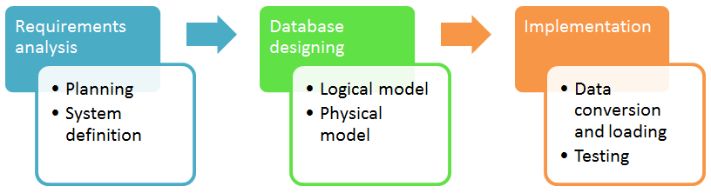
Database development life cycle
It helps produce database systems
That meet the requirements of the users
Have high performance.
Database designing is crucial to high performance database system.

Slide 49
Temporal Data Base
A temporal database stores data relating to time instances. It offers temporal data types and stores information relating to past, present and future time.
Temporal databases could be uni-temporal, bi-temporal or tri-temporal.
More specifically the temporal aspects usually include valid time , transaction time or decision time.
Valid time is the time period during which a fact is true in the real world.
Transaction time is the time at which a fact was recorded in the database.
Decision time is the time at which the decision was made about the fact.

Slide 50
Features of Temporal Data Base
Temporal databases support managing and accessing temporal data by providing one or more of the following features:
A time period datatype, including the ability to represent time periods with no end (infinity or forever)
The ability to define valid and transaction time period attributes and bitemporal relations
System-maintained transaction time
Temporal primary keys, including non-overlapping period constraints
Temporal constraints, including non-overlapping uniqueness and referential integrity
Update and deletion of temporal records with automatic splitting and coalescing of time periods
Temporal queries at current time, time points in the past or future, or over durations
Predicates for querying time periods, often based on Allen’s interval relations

Slide 51
Summary
Database designing is critical to the successful implementation of a database management system that meets the data requirements of an enterprise system.
Normalization in DBMS helps produce database systems that are cost-effective and have better security models.
Functional dependencies are a very important component of the normalize data process
Most database systems are normalized database up to the third normal forms.
A primary key uniquely identifies are record in a Table and cannot be null
A foreign key helps connect table and references a primary key

Slide 52
RDBMS Quick Guide ( Summary )
https://www.tutorialspoint.com/dbms/dbms_quick_guide.htm .
Useful Links on DBMS :
DBMS at Wikipedia - This is information about DBMS at Wikipedia.
SQL at tutorialspoint - This is Tutorialspoint tutorial for SQL.
Encyclopedia - Encyclopedia of Database Systems .

Slide 53



